Slide 1
Agile Processes
Dirk Riehle, Univ. Erlangen
AMOS B03
Licensed under CC BY 4.0 International

Slide 2
Reminder About Common Mistakes
Please sign-off your commits and declare your co-authors, if any
During sprint review, please show and tell, don’t just talk
Don’t forget the next sprint preparation meeting
Don’t forget your team T-shirt preferences

Slide 3
Agenda
Software development
Plan-driven development
Agile methods
Scrum
Build process review

Slide 4
1. Software Development

Slide 5
Products vs. Projects
Products have a life-cycle; may live forever
Products are developed for a market (many customers)
Projects have a defined start and end date
Projects are developed for one client (one customer)

Slide 6
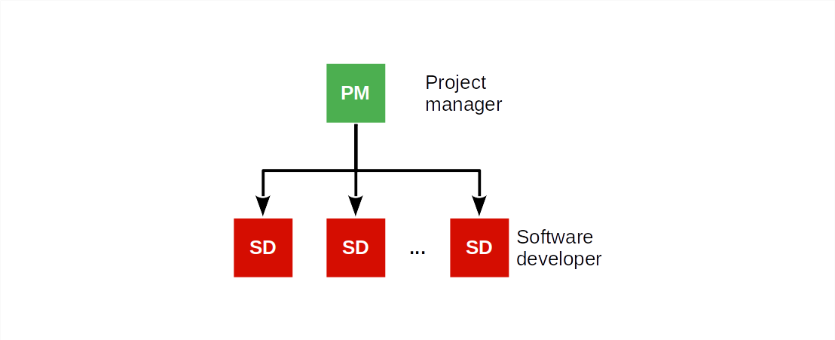
Traditional Software Project Organization (Consulting Firm)

Slide 7
Job Descriptions in Software Consulting Projects
A project manager is responsible for
Planning, managing, and delivering the project results to clients
A software developer is responsible for
Implementing the functionality as requested by the project manager

Slide 8
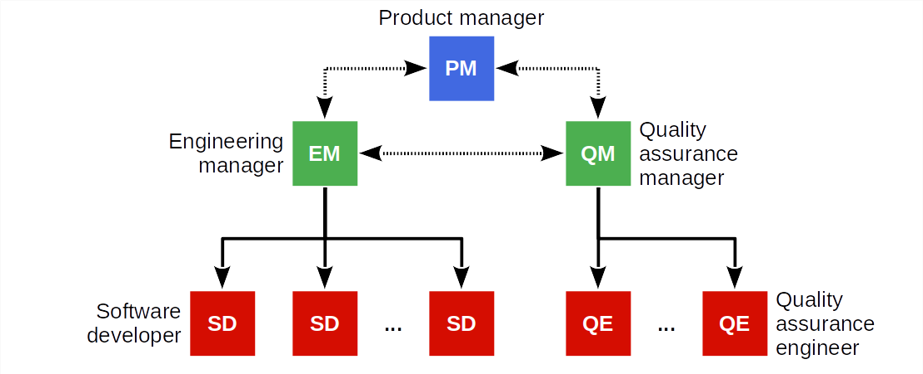
Traditional Software Product Organization (Vendor)

Slide 9
Job Descriptions in Software Product Development
A product manager is responsible for
What needs doing
An engineering manager is responsible for
Who gets to do it and when
A software developer is responsible for
How it gets done and how long it will take
Quality assurance is responsible for
Ensuring that the product meets the expectations

Slide 10
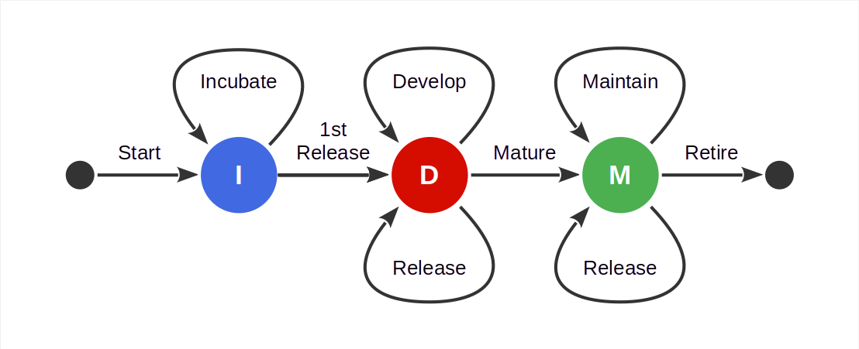
Basic Software Product Life-Cycle

Slide 11

The Magic Triangle (“Pick Two”)

Slide 12
2. Plan-Driven Development

Slide 13
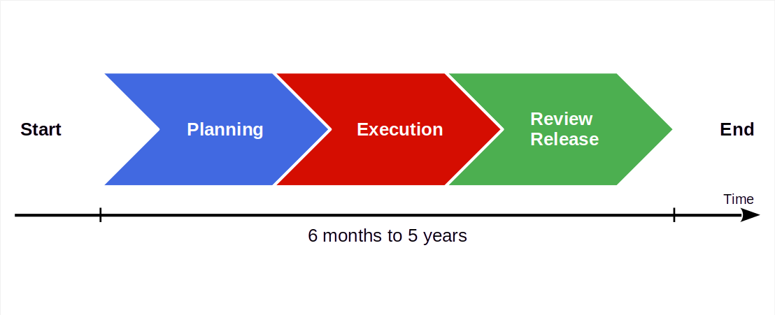
Basic Plan-Driven Development

Slide 14

Video From “The Pentagon Wars” [1]
[1] See https://youtu.be/r0op8e0LuoU

Slide 15
Video Lessons
Stakeholders problems
Multiple stakeholders with conflicting interests
Meddling stakeholders intervening into the process
Requirement problems
Inconsistent requirements (poor quality assurance)
Changing requirements (wandering focus, long project)
Feature creep (from troop carrier to tank)
Product problems
Cost explosion due to lack of focus, rework
Unclear market and wandering purpose

Slide 16
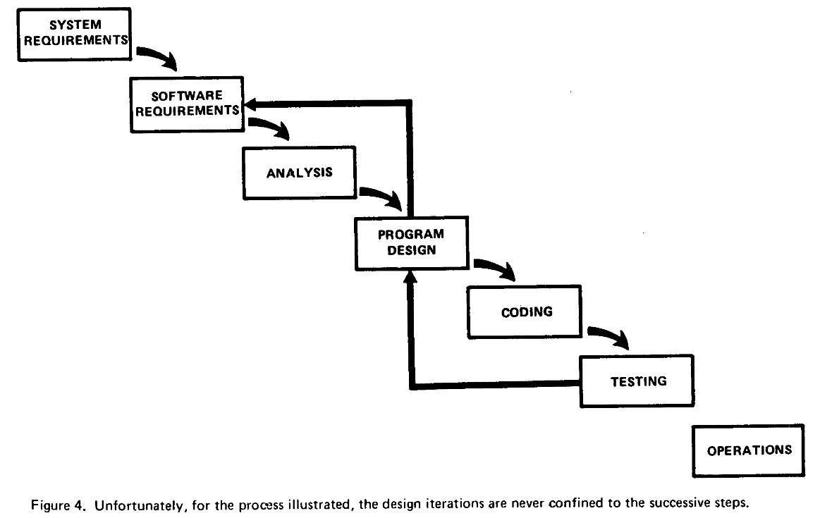
The Waterfall Model [1]
[1] Royce, W. W. (1970). Managing the development of large software systems. Proceedings of IEEE WESCON. Los Angeles, 328-388.

Slide 17
Main Lesson From Plan-Driven Development
Phases ≠ Activities

Slide 18
3. Agile Methods

Slide 19
Agile Methods
Agile methods are a category of software development methodologies
Defined in opposition to plan-driven development
Driven by consultants as a significant business opportunity
The key idea of agile methods is to have a fast feedback loop
Steer, don’t plan and blindly execute
Codified as the agile manifesto
Examples agile methodologies
Scrum, XP, the Crystal Methods, Feature Driven Development

Slide 20
Principles of the Agile Manifesto [1]
Individuals and interactions
Over processes and tools
Working software
Over comprehensive documentation
Customer collaboration
Over contract negotiation
Responding to change
Over following a plan
[1] See https://agilemanifesto.org

Slide 21
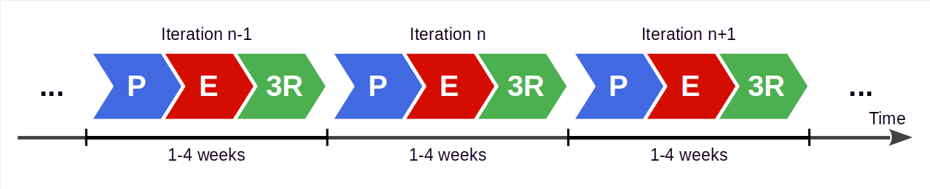
Agile Development Process
Succession of equal-length iterations (“time-boxes”, “sprints”)
Intervention points are during planning and review
User feedback only available during review
P = Planning
E = Execution
3R = Review, release, and retrospective

Slide 22
Benefits of Fast Feedback Loops
Short iterations
Short iterations lead to focus on high-value features first
Established well-worn rhythm is sustainable, avoids burnout
Partial functionality is better than none
User feedback
User feedback helps steer project or product to meet user needs
Feedback loop ensures that problems surface early
Feedback helps recognize and realize new innovative features

Slide 23
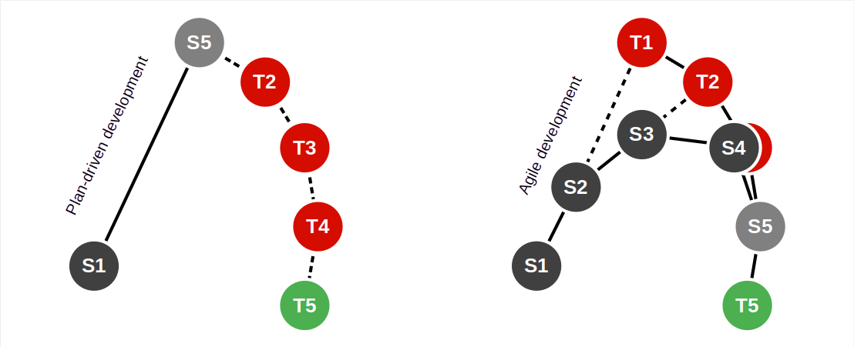
Plan-Driven vs. Agile Processes

Slide 24
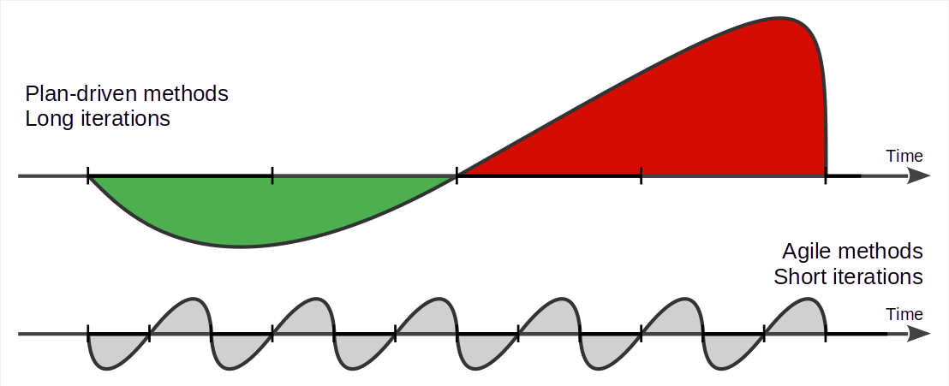
Plan-Driven vs. Agile Work Rhythms

Slide 25
Do Agile Methods Lead to Cowboy Coding?
Agile methods are high discipline

Slide 26
4. Scrum

Slide 27
Scrum [1]
Scrum is an agile method (framework) invented around 1993, 1995
Has a minimal (agile) process model
Is applicable to any domain, not just software development
[1] Schwaber, K., & Sutherland, J. (2020). The scrum guide. Web-published.

Slide 28
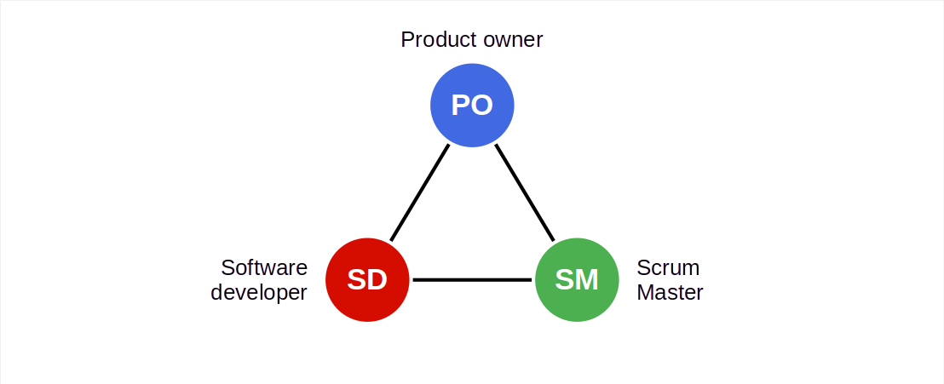
Scrum Roles / Scrum Team [1]
[1] The Scrum team is one Scrum Master, one product owner, software developers

Slide 29
Committed vs. Involved Roles
Committed roles
Product owner
Software developer(s)
Scrum Master
Involved roles
Customer
Sponsor / funder
Regulators
…

Slide 30
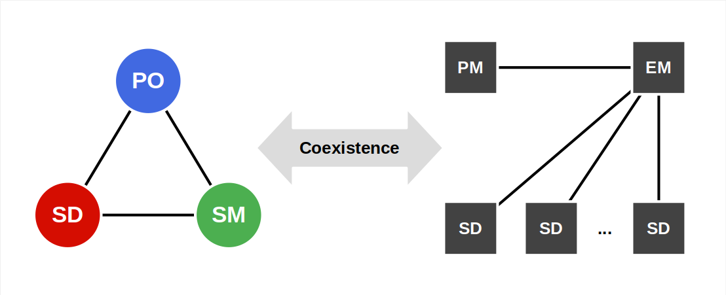
Mapping Roles to Posts

Slide 31
Roles / Posts Correspondence
Scrum | Custom projects (consulting firms) | Product development (vendors)
Product owner | Project manager | Product manager Engineering manager
Software developer | Project manager Software developer | Software developer Engineering manager Quality assurer
Scrum Master | Project manager | Engineering manager

Slide 32
Terms (The Scrum Terminology Mess)
Scrum | Custom projects | Product development
Product owner | Business analyst, Requirements engineer | Product manager
Product goal | Project mission [1] | Product vision [1]
Product backlog | Requirements specification | Product requirements document (PRD)
[1] This resolution is specific to AMOS, though the terms are generally known and used

Slide 33
Scrum Scope / Time Horizons
Scrum proper covers
Day
Sprint (weeks)
Arguably implied by Scrum
Releases (months)
Project/product (years)
Further evolutions e.g. SAFe cover
Product life-cycle (years)
Portfolio

Slide 34
Daily Scrum (a.k.a. Daily Standup)
The daily scrum is
A daily status meeting to sync on problems and upcoming work
To be kept as short as possible
Committed parties are mandatory
Only committed parties may speak
Everyone else is optional
Discussions are not allowed, but
Can be had one-on-one after the meeting
Scrum Master will follow-up on problems

Slide 35
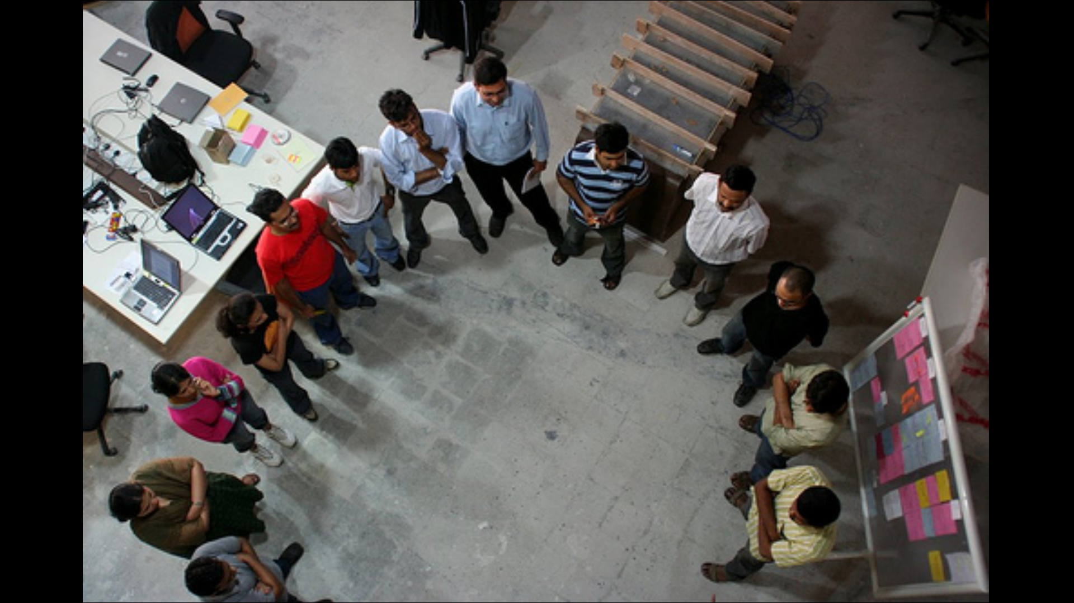
Daily Scrum

Slide 36
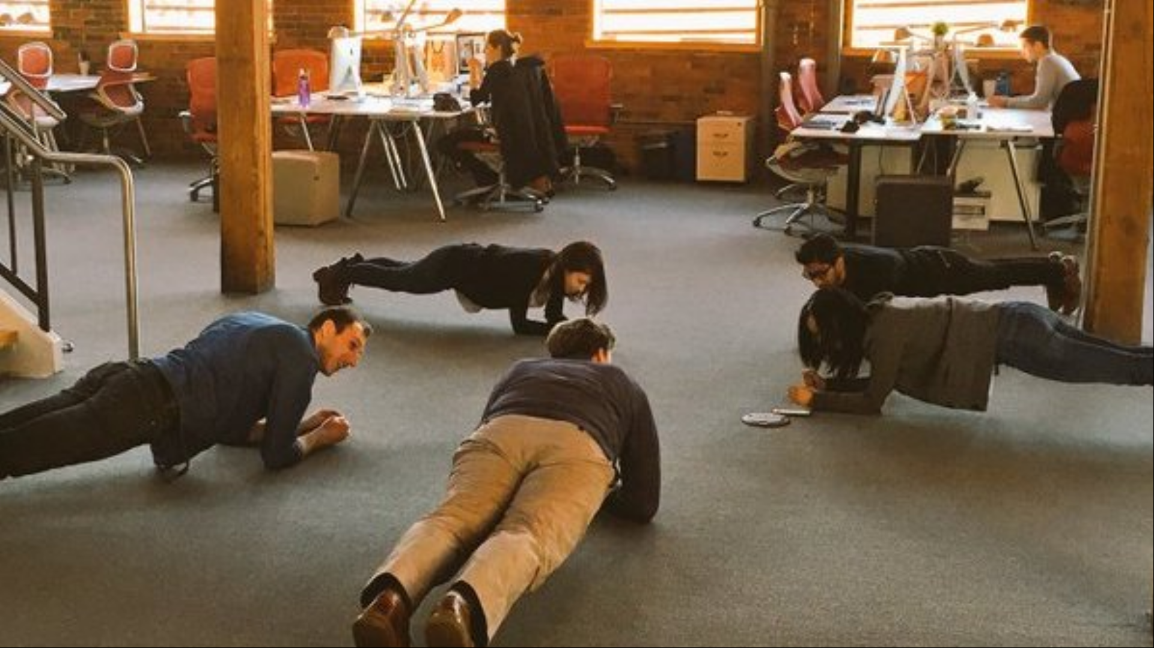
Daily Plank

Slide 37
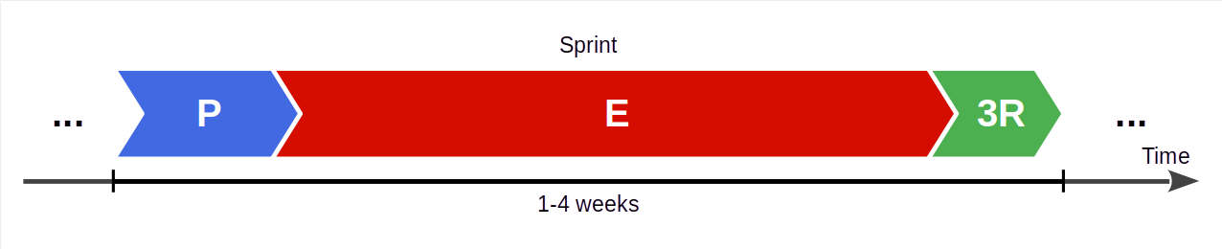
Scrum Sprint
A sprint is Scrum’s iteration; it is an equal-length time-box
It is a highly structured process with defined feedback points

Slide 38
Increment of Value
An increment of value is
Some added value to current or new artifacts
Increments of value are mainly provided by
Sprints (via sprint release)
Basically, anything that has a definition of done

Slide 39
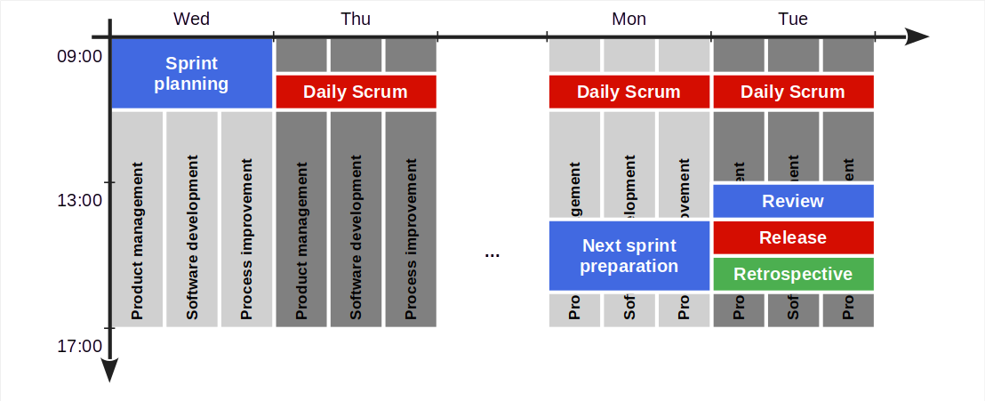
Sprint Structure

Slide 40
Sprint Meetings
The AMOS
team meeting
Next sprint preparation
Product owner and senior developer groom the product backlog
Sprint review
Team reviews this sprint’s results, signs off on them
Sprint release
Team decides on sprint release
Sprint retrospective
Team reviews process, commits to improvements
Sprint planning
Team discusses upcoming work, commits to it
Daily Scrum
Team members update each other on work progress

Slide 41
Sprint Workstreams
Product management; the product owner
Builds and grooms the product backlog
Answers questions to developers
Software development; software developers
Break down backlog items into tasks, self-organize
Design and implement sprint backlog items
Process improvement; the Scrum Master
Observes problems and opportunities
Facilitates impediments resolution and improvements

Slide 42
5. Build Process Review

Slide 43
Milestone: Build Process Review
We expect you to demo a working build and run process
One command to trigger and perform a full build
One command to start the software for demoing purposes
All of this independently of a particular person’s machine
We will call arbitrarily on people to show this
Feel free to coordinate with and learn from other teams

Slide 44
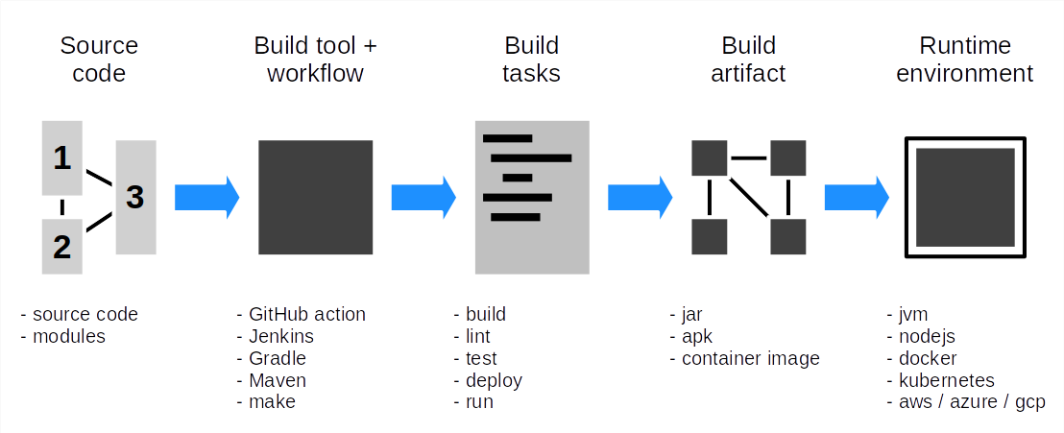
How to Discuss Build Input, Pipeline, and Artifacts

Slide 45
Summary
Software development
Plan-driven development
Agile methods
Scrum
Build process review

Slide 46
Thank you! Any questions?
dirk.riehle@fau.de – https://oss.cs.fau.de
dirk@riehle.org – https://dirkriehle.com – @dirkriehle

Slide 47
Legal Notices
License
Licensed under the CC BY 4.0 International license
Copyright
© Copyright 2009, 2024 Dirk Riehle, some rights reserved

Slide 48
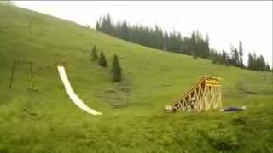
Megawoosh! [1]
[1] See https://www.youtube.com/watch?v=D7rbiLNf-JI

Slide 49
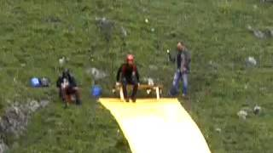
Video Lessons [1]
[1] See https://youtu.be/_n065KE00J0

